Slide 1
Use OpenCV to Detect Human Faces
(Based On Python)
Li Weijian,China,2019/1/30

Slide 2
Environment
System：Windows 10 x64
Language：Python 3.6
IDE：Pycharm

Slide 3
Data Directory Structure
Data0
|-------face1.jpg
|-------face2.jpg
|-------….jpg
|-------face1054.jpg
Extract all images into one folder, in order to operate easily in the program
Data
|------s1
| |----face1.jpg
| |----….jpg
|------s2
| |----face1.jpg
|------…
Rename every folder name with s<Label>,
Integer labels assigned
to that people
Origin_data
Original folders directly downloaded from web.
Used for backup

Slide 4
Data Directory Structure (2)
OpenCV face recognizer accept data in a specific format. It accepts two vectors, one vector is of faces of all the persons and the second vector is of integer label for each face so that when processing a face the face recognizer knows which person that particular face belongs to.
there is no label0 in the training data so s0 is empty
subject = [ “”, ” Aaron_Eckhart”, ” Aaron_Guiel”, …, ” Azra_Akin” ]

Slide 5
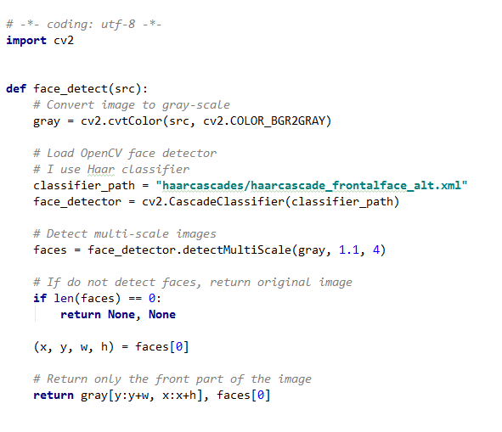
FaceDetect.py
I choose Haar classify as face detector though it is a little bit slow but more accurate.
From detected faces I only pick the first one, because in one image there is only one face.
I extract face area from gray image and return both rectangle and face image

Slide 6
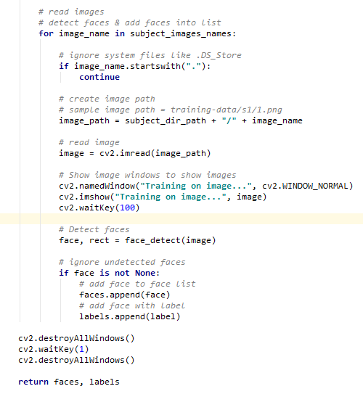
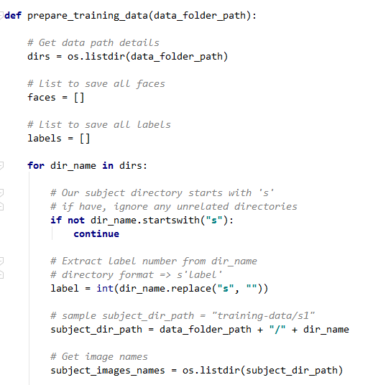
DataPrepare.py

Slide 7
DataPrepare.py (2)
This file will read all images and append all of them into faces list and label list
Imshow all the images to ensure all the image are available
Due to we have 1054 images so it will spend about 1 min or less

Slide 8
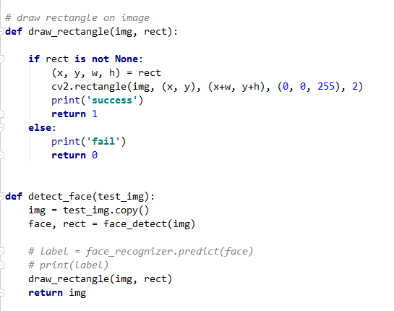
DetectFace.py
There are 3 main functions here.
The first one is a function to draw rectangle on faces, if face is detected, the console will print success and return 1 (this is what a need in accuracy computing function)
Else it will print fail and return 0

Slide 9
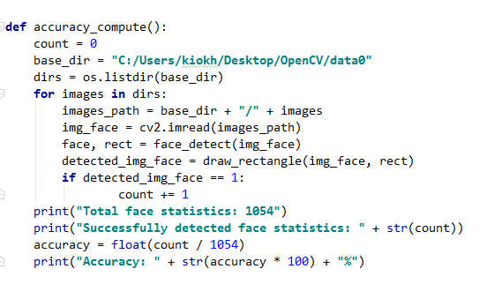
DetectFace.py (2)
The second function is detecting face, just draw rectangle on images and return the image
The last is for computing accuracy,
I created data0 folder (in page 3) which is exactly served for this operation. It use the draw_rectangle function to find if it draws successfully and count the number when it successed.

Slide 10
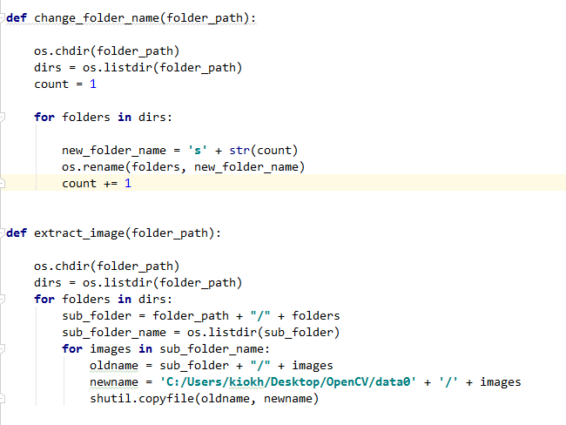
FolderNameChange.py
This file help me simply create data folder and data0 folder from original folder

Slide 11
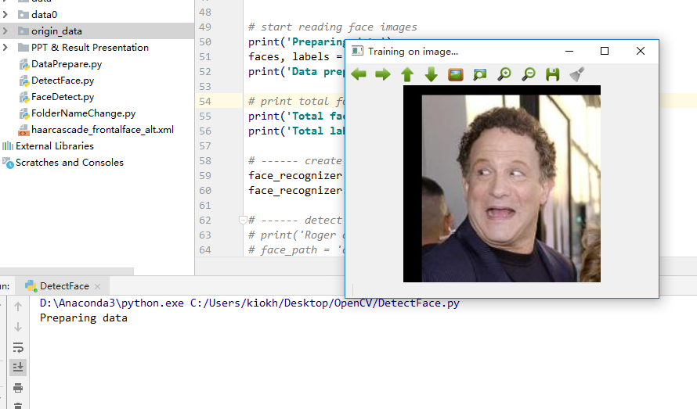
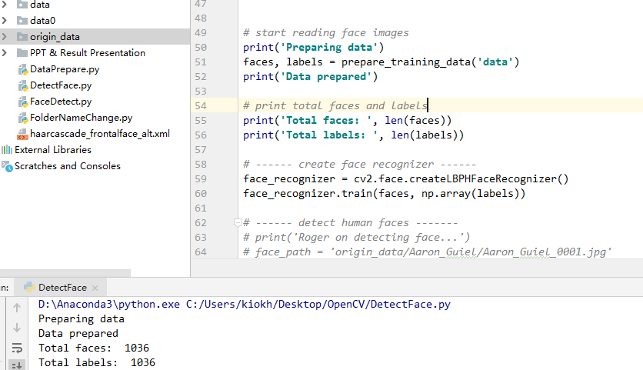
Result Demonstration
This is a machine learning process, first I read all the face files and add them to the list, and then I
Use the BPH face recognizer to train the files in the list

Slide 12
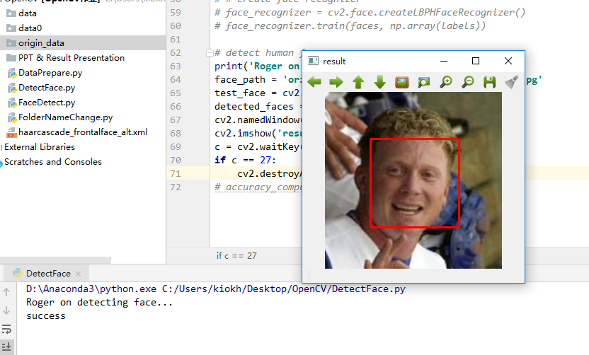
Result Demonstration (2)
How to show that I successfully identify a human face?
Of course drawing a remarkable rectangle around the face.
When it identifies the face in success, it opens the file and draw a red rectangle around the face its success.

Slide 13
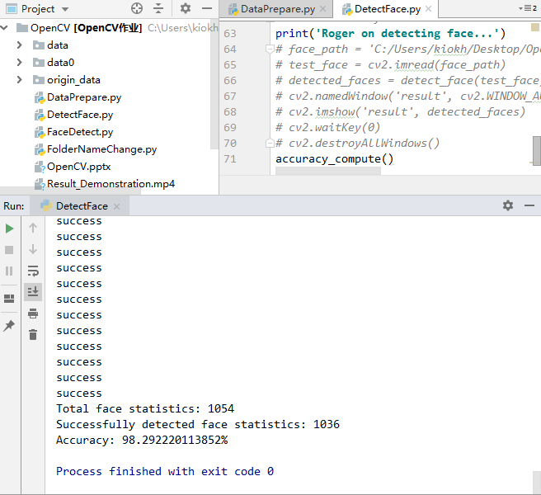
Result Demonstration (3)
According to the result of the accuracy_compute function , I identified all the 1054 face files in the folder, and finally successfully identified 1036 of them, the accuracy reached :
98.292220113852%

